Slide 1





Project: Home Irrigation Control System (HICS) Team: SmartGrass
CSE Senior Design I
Architecture Design Specification
CSE 4316 Final Exam
Belachew
Haile-Mariam(L)
Gautam
Adhikari
Jeremiah
O’Connor
Tung
Vo
Notes:
This presentation demonstrates the new capabilities of PowerPoint and it is best viewed in Slide Show. These slides are designed to give you great ideas for the presentations you’ll create in PowerPoint 2010!
For more sample templates, click the File tab, and then on the New tab, click Sample Templates.

Slide 2
GUIDING PRINCIPLES
1
Gautam

Slide 3
Guiding Principles
Scalability
Users will have the freedom to add or remove irrigation valves or soil moisture sensors
Hardware expansion components will be incorporated into the HICS controller

Slide 4
Guiding Principles
Ease of Use
HICS will be easily accessible to users of all technical backgrounds
Web application interface must be intuitive and user-friendly
Limited number of simple steps to control the irrigation system
Large and descriptive UI elements (buttons, labels, etc.)

Slide 5
Guiding Principles
Maintainability
HICS will require minimal maintenance after purchase
All sensors should be replaceable and reinstallation should be possible at the user level
Plug and play type interface for connecting each sensor to the central control unit

Slide 6
Guiding Principles
Compatibility
HICS should work with most of the existing sprinkler systems
Central control unit should be built to connect directly with valve wires

Slide 7
LAYER DEFINITIONS
2
Billy

Slide 8
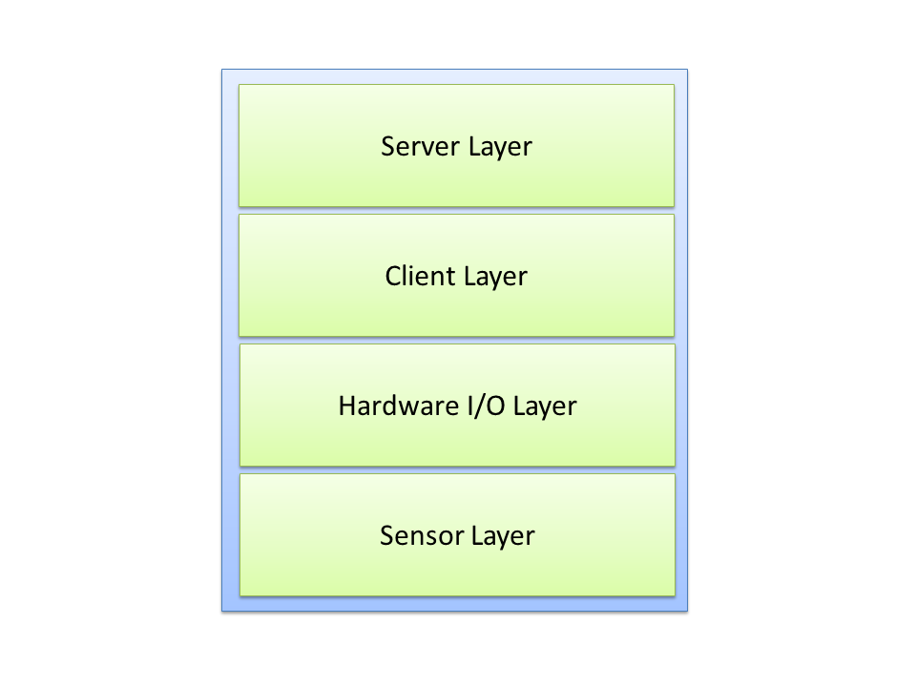
Layer Structure Overview

Slide 9
Sensor Layer
Purpose
Gather readings as data from all sensors to monitor different environment conditions
Providing service(s):
Send all the different environment condition readings to the Hardware I/O Layer
Expecting service(s):
The layer is not expecting any service from another layer

Slide 10
Hardware I/O Layer
Purpose
Collect and parse all information from the environment sensors
Control the on and off activities of the irrigation valves
Providing service(s):
Collect input data from the sensors
Differentiate the input
Format the data to be sent to Client Layer
Expecting service(s):
Sensor readings as input data from the Sensor Layer
Control commands from the Client Layer

Slide 11
Client Layer
Purpose
Handle communication between Hardware I/O Layer and Server Layer
Providing service(s):
Receive formatted sensor data from the Hardware I/O Layer
Receive response commands from the Server Layer
Expecting service(s):
Translated sensor input data from Hardware I/O Layer
Data response commands or status codes from the Server Layer

Slide 12
Server Layer
Purpose
Handle the interfacing between the user and the web application
Process the requests from Client Layer and return command data
Store and update sensor and watering schedule data on the Database
Providing service(s):
Send command or status code responses to the Client Layer
Provide the GUI for user interaction
Expecting service(s):
Requests from Client Layer with sensor data or update requests for commands

Slide 13
SUBSYSTEM DEFINITIONS
3
Tung

Slide 14
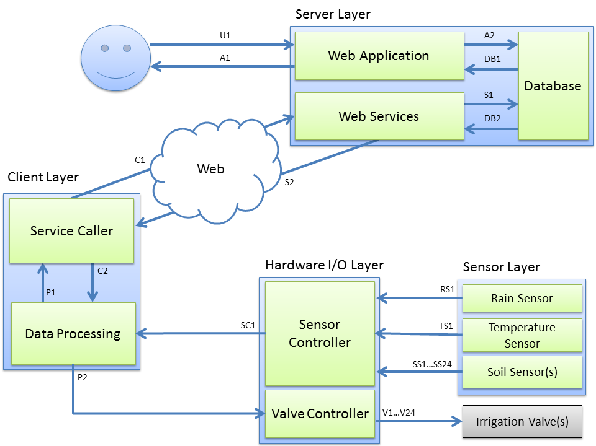
Subsystem Data Flow Diagram

Slide 15
Sensor Layer Subsystems
Rain Sensor:
Detect precipitation amounts by collecting rainfall to alert a rain condition to stop watering
Temperature Sensor:
Measure the current temperature of the environment to turn off system in freezing condition
Soil Moisture Sensor(s):
Measure the current soil moisture levels at each corresponding irrigation zone to decide to turn irrigation valves on or off

Slide 16
Subsystem Data Flow Diagram

Slide 17
Hardware I/O Layer Subsystems
Sensor Controller:
Interface directly to all sensors to read and parse the signals transmitted from the sensors
Send the formatted sensor input to Data Processing subsystem
Valve Controller:
Interface directly to the irrigation valves
Receive control commands from the Data Processing subsystem to turn the valves on or off

Slide 18
Subsystem Data Flow Diagram

Slide 19
Client Layer Subsystems
Service Caller:
Take information from the Data Processing subsystem and send it to the Web Service subsystem
Receive responses from the Web Service and relay it back to Data Processing subsystem
Data Processing:
Parse sensor data from the Sensor Controller, process the information, and pass it to Service Caller
Process response data from the Service Caller to determine irrigation valve commands to relay to the Valve Controller

Slide 20
Subsystem Data Flow Diagram

Slide 21
Server Layer Subsystems
Web Application :
Provide the GUI to interact with the users
Collect input from keyboard and mouse events from the user
Database:
The central hub for data communication between the Server and Client layers
Store and retrieve data (sensor readings, account information etc.) from the DBMS
Web Services:
The communication link between the Client systems and the Database

Slide 22
INTER-SUBSYSTEM DATA FLOW
4
Jeremiah

Slide 23
Data Flow Descriptions
Data Element ID | Description | Source | Sink
U1 | User enters input into the web application or interacts with the applications GUI. | User or Admin | Web Application
A1 | User requested data is presented through the application GUI on the user’s web or mobile browser. | Web Application | User or Admin’s web or mobile browser.
A2 | Data is received from the user to either update or request information about their system. | Web Application | Database
DB1 | Requested data from the web application query is located and returned. | Database | Web Application
DB2 | Requested data from the web service query is located and returned. | Database | Web Services

Slide 24
Data Flow Descriptions
Data Element ID | Description | Source | Sink
S1 | The data requested from the client is queried or data is sent to the database for storing. | Web Services | Database
S2 | The service caller receives a response from a web service with requested information or a response status code. | Web Services | Service Caller
C1 | A request sent to the web service for either a valve switch command (on/off), data update response, or the caller sends new sensor readings for storage. | Service Caller | Web Services
C2 | Data returned by the web service is relayed to the data processor to check for valve switch commands to turn the water valves on or off. | Service Caller | Data Processing

Slide 25
Data Flow Descriptions
Data Element ID | Description | Source | Sink
P1 | Data from the sensors is processed and formatted then passed to the service caller. | Data Processing | Service Caller
P2 | Response data from the service caller is processed and an operation command is sent to the valve controller. | Data Processing | Valve Controller
SC1 | Parsed data from the sensors is sent to the data processing subsystem. | Sensor Controller | Data Processing
IV1+ | Control signals are parsed and sent to the irrigation valves to turn them on or off. | Valve Controller | Irrigation Valve(s)
RS1 | An alert signal is sent from the rain sensor if a specified amount of rain has been detected. | Rain Sensor | Sensor Controller
TS1 | A temperature reading from the temperature sensor is sent to the sensor controller for parsing. | Temperature Sensor | Sensor Controller
SS1+ | Soil moisture readings are sent from the soil sensors to the sensor controller for parsing. | Soil Sensor(s) | Sensor Controller

Slide 26
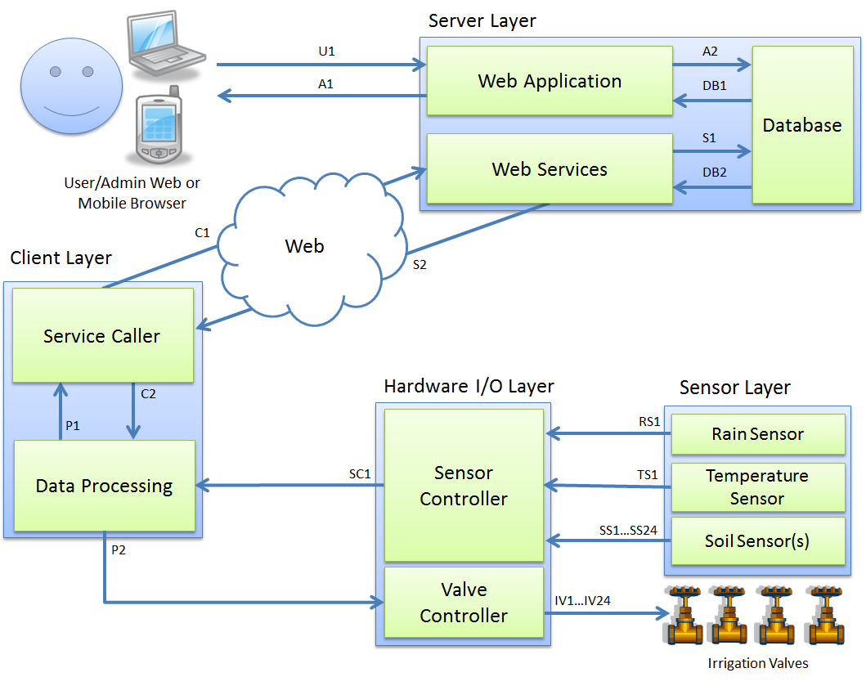
Subsystem Data Flow Diagram

Slide 27
QUESTIONS?
?

